Slide 1
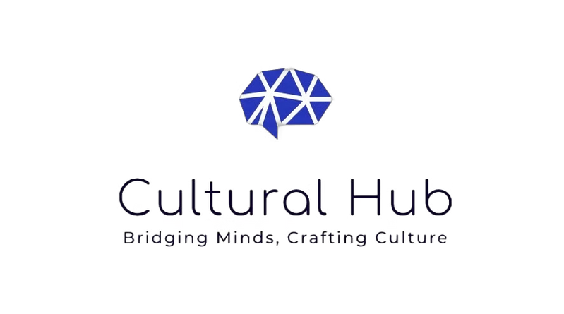
Cultural Hub: An AI-Powered Collaborative Platform for Culturally Significant Content
Connecting authors, educators, and historians to preserve and share cultural heritage.
Team Name: Traditional Embers
Team Members:
K. Tanusha
M. Jyothi Krishna
T. Lahari
Hackathon Name & Date: AI Hack Day-2024& 25-01-2025
Notes:
1

Slide 2
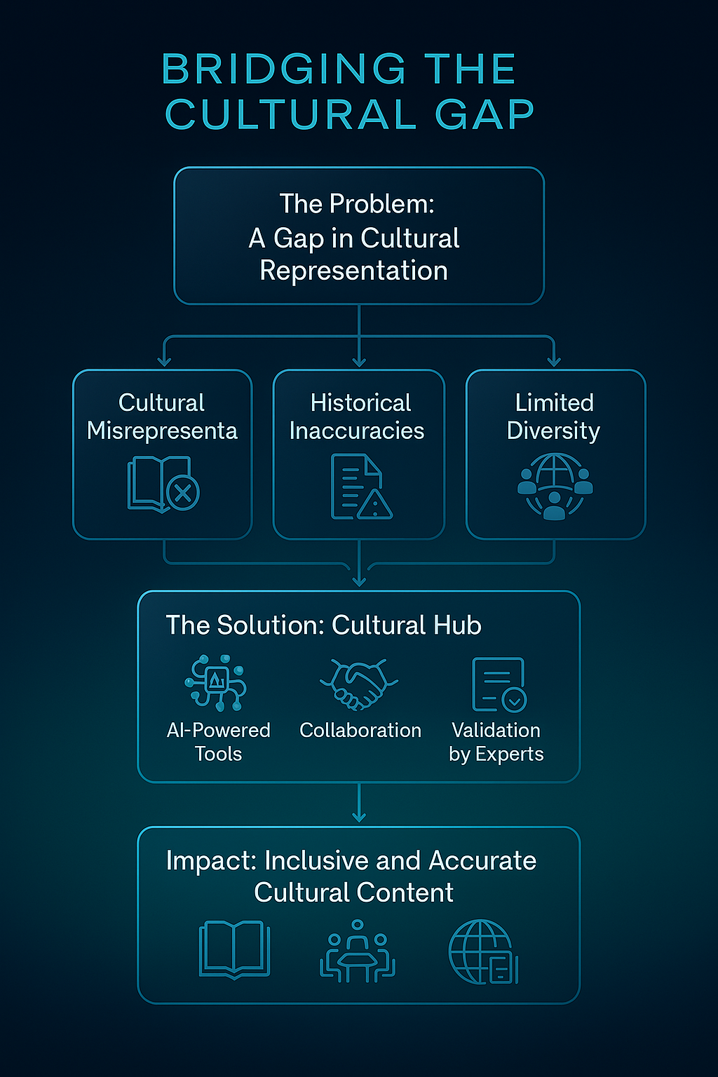
The Problem
85% of global educators believe more culturally inclusive material is needed in classrooms, and publishers report a growing demand for culturally diverse books.
To develop a collaborative, AI-powered platform that empowers authors, educators, and historians to co-create and validate culturally significant, accurate, and engaging content. The platform aims to enhance global cultural representation in literature and educational resources, promoting inclusivity and preserving cultural heritage.
Notes:
2

Slide 3
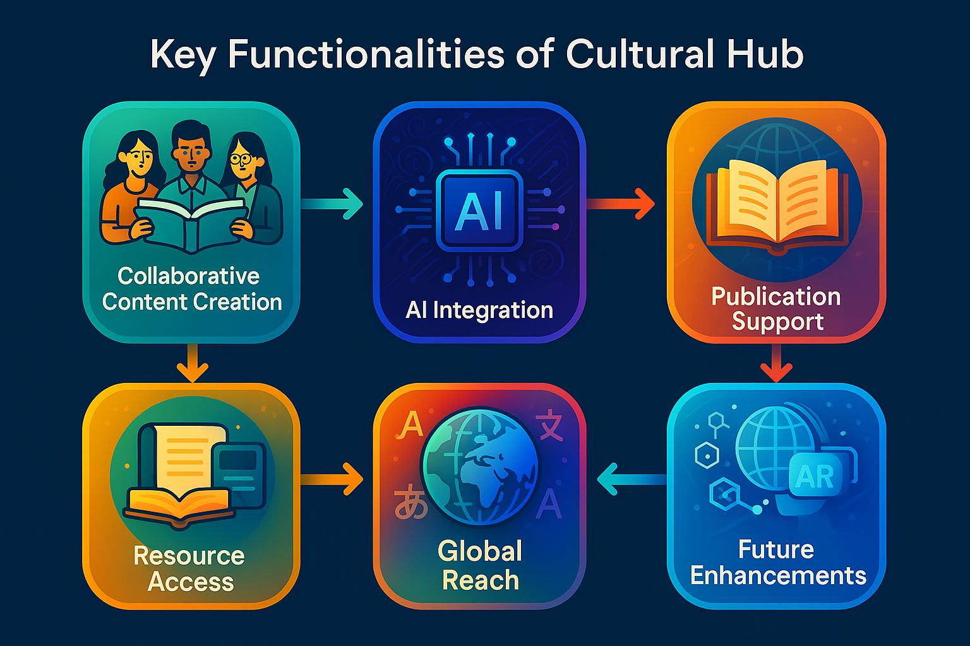
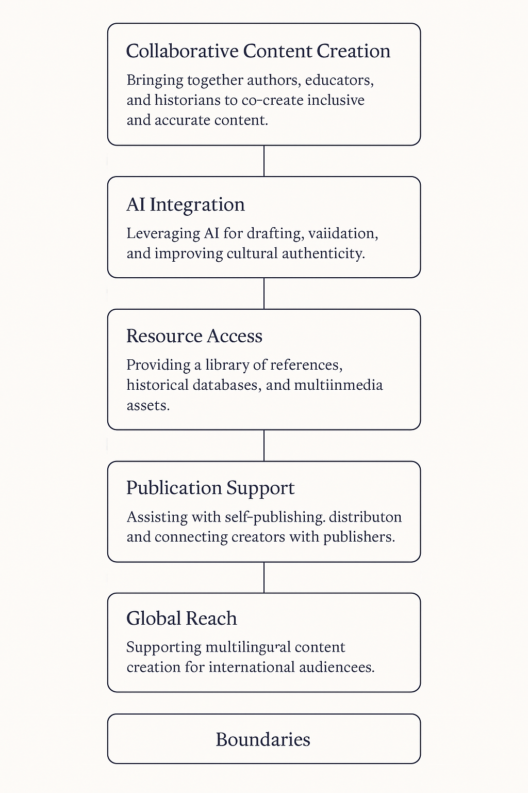
Scope of the project:
Notes:
6

Slide 4
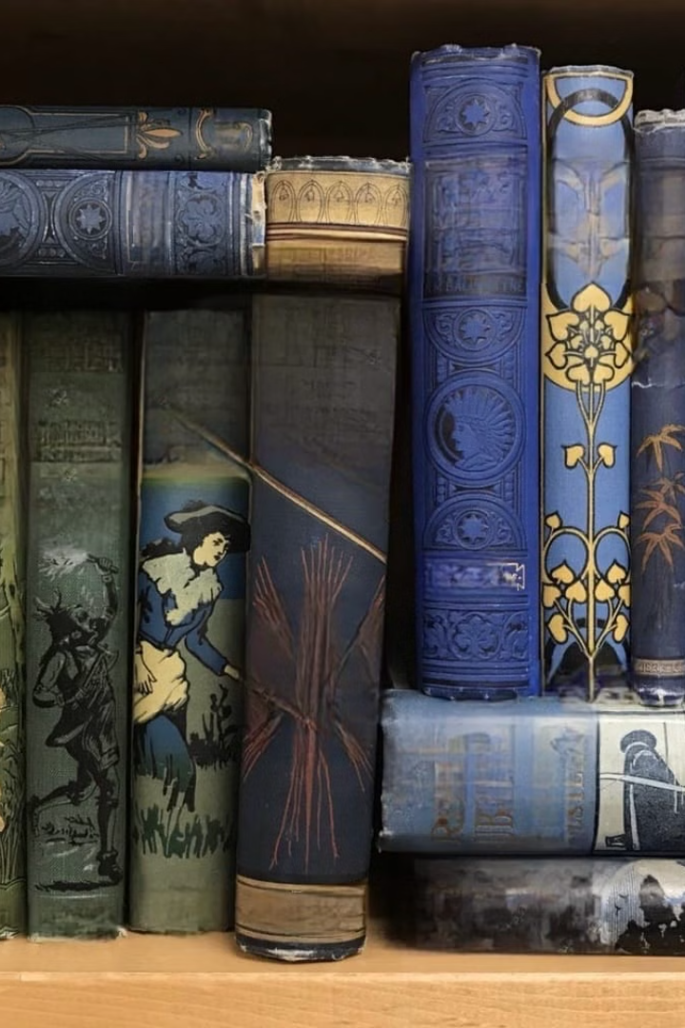
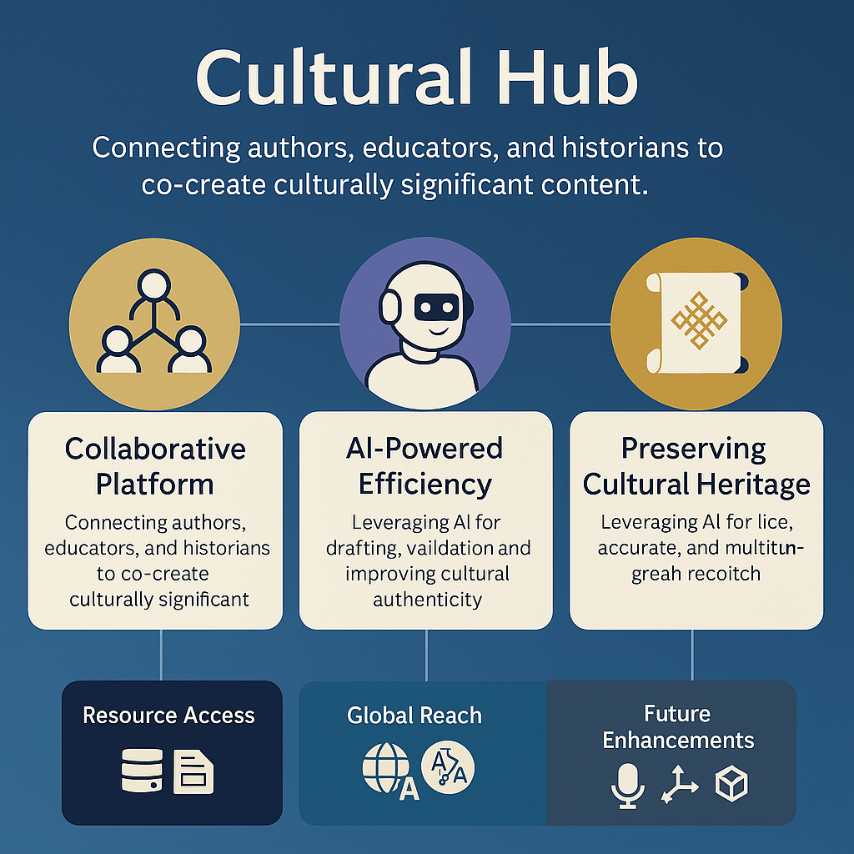
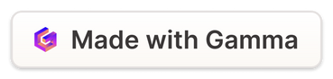
The Solution: Cultural Hub
Unique Concept/Idea:
The project redefines the creation and preservation of culturally significant content by integrating collaboration include:
Triangular Collaboration
AI-Enhanced Cultural Validation
Interactive Development
Blending Technology with Heritage
Inspiration
A Need for Inclusivity: To address the lack of representation and diversity in educational materials and literature.
Global Trends: Rising global interest in multicultural education and diverse storytelling for better understanding .
Preserving Cultural Heritage: Using technology to ensure cultural traditions, stories, and accurate histories are preserved with future generations.
Notes:
3

Slide 5
Key Features: Empowering Content Creators
Collaborative Writing Space
AI-Powered Content Generation
Cultural Sensitivity & Accuracy Checker
Real-time teamwork on stories, books, and lesson plans.
Assists with drafting, brainstorming, and creating content.
Ensures quality and avoids misrepresentation.
Interactive Story Development Tools
Multilingual Support
Feedback and Review System
Making the content interactive through image integration
For global accessibility
Through AI and collaborators to improve content collaboratively.
Access to Resources and set your mood
Publication Services
AI Detector
A library of culturally significant references, research materials, and historical databases. Not that you can set your mood accordingly for your writing preferences
Assistance in self-publishing books, distributing digital content, and connecting with publishers.
Identifies AI-generated content in collaborative submissions to ensure transparency and distinguish between human-written and AI-generated text.
Humanize AI
Marketing page
Plagiarism Checker
Enhances AI-generated content by adding a natural, human-like tone and creativity, making it more relatable and culturally authentic.
Ensures originality of content by scanning for similarities with existing works and providing detailed reports.
IT gives a one stop marketing destination for all the authors
Notes:
4

Slide 6
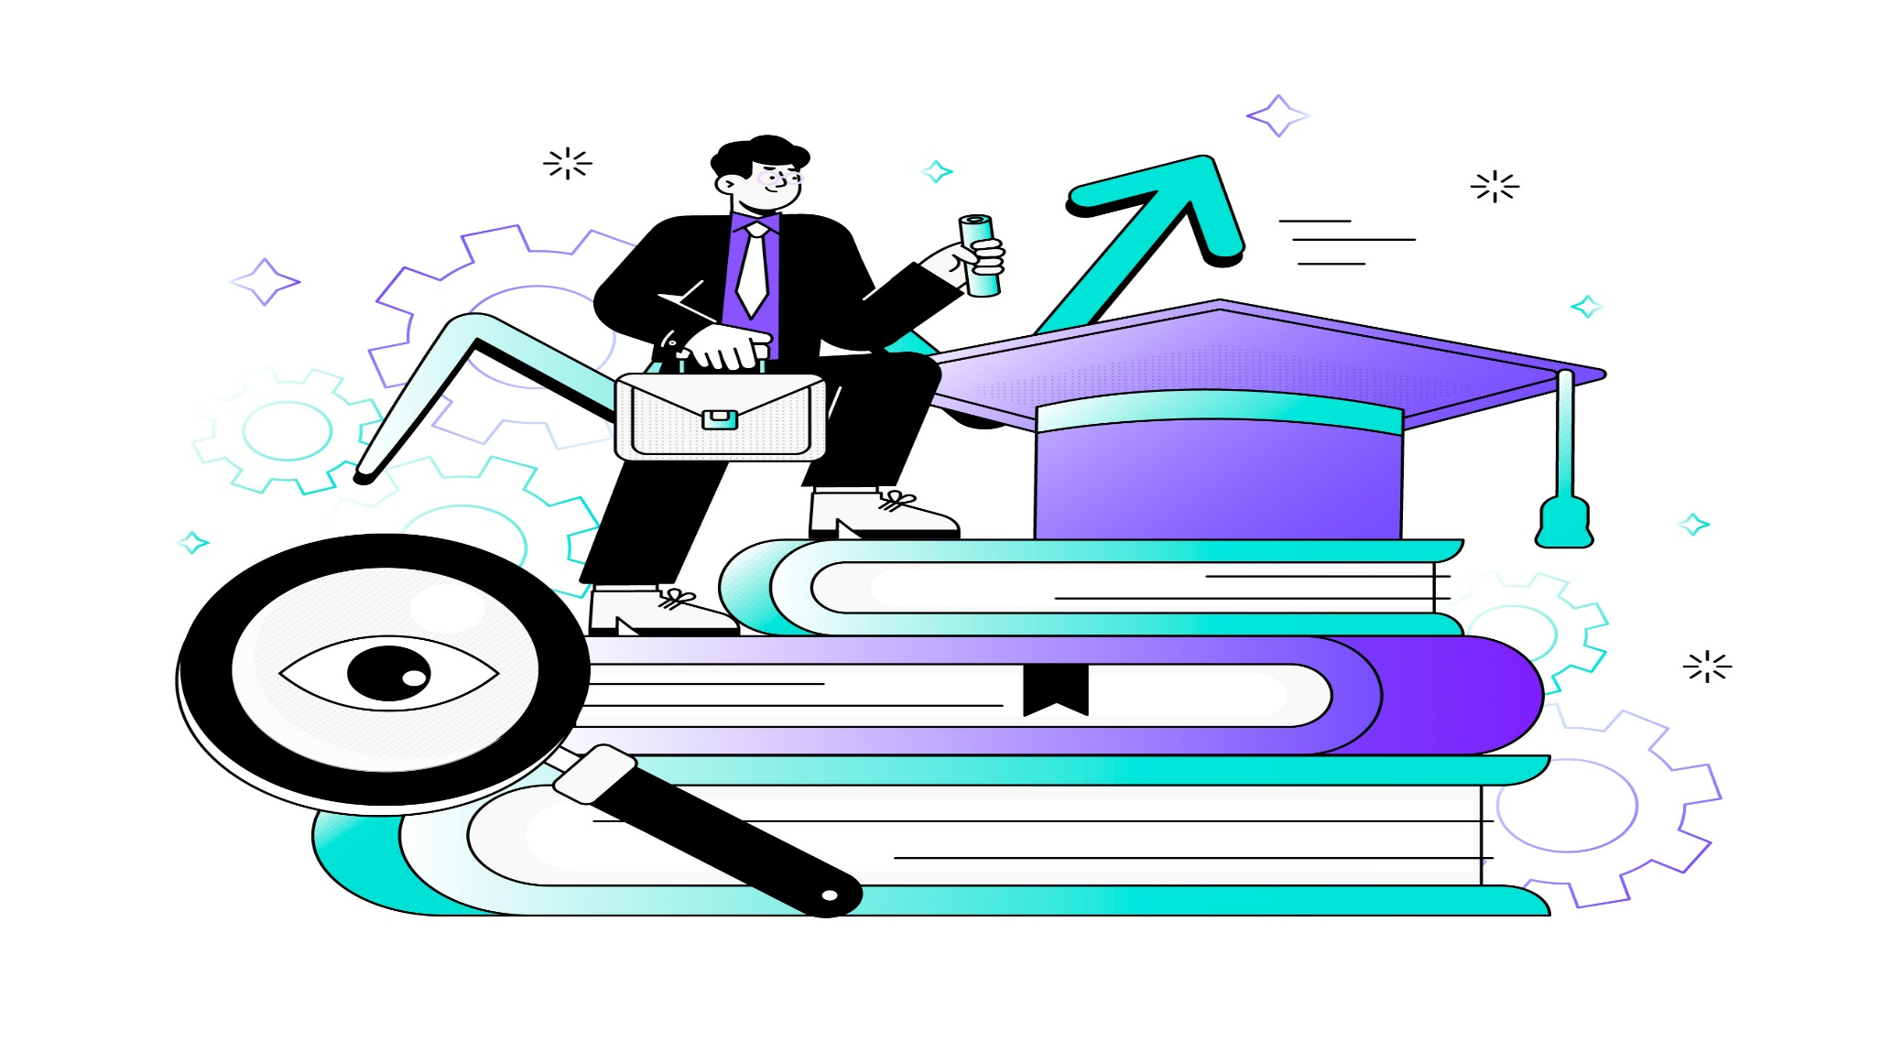
How It Works: A Collaborative Workflow
Author Creation
1
Draft culturally significant stories, books, or lessons.
Educator Refinement
2
Align content with curriculum standards and learning outcomes.
Historian Validation
3
Ensure accuracy and cultural sensitivity.
AI Assistance
4
Suggestions, checks, and multimedia resources.
Content Repository
5
Finalized content available for public or educational use.
Notes:
5

Slide 7
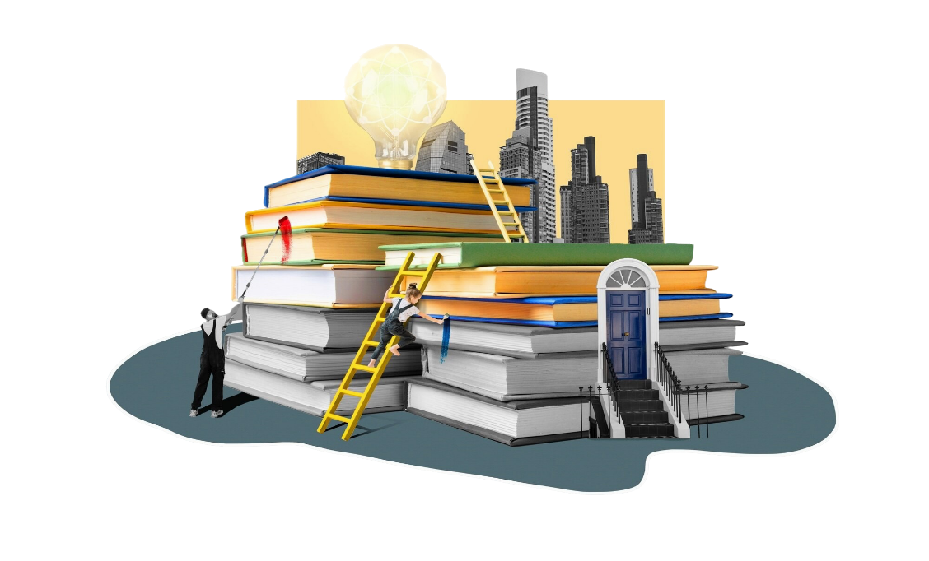


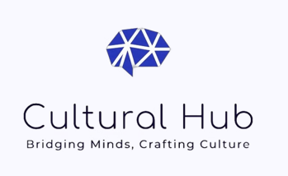
CULTURAL HUB – WORK FLOW
NEED TO FIND AN AUTHOR FOR PUBLISHING A BOOK FROM MY PUBLISHING HOUSE
WANT TO PUBLISH A BOOK BUT NEED TO FIND A PUBLISHER
I WANT TO READ A GOOD BOOK OF MY FAVOURITE GENRE
COLLABORATOR/PUBLISHER
READER
AUTHOR

Slide 8





AI Integration: Powering the Platform
Content Generation
Cultural Sensitivity and Historical Accuracy Checker
Multimedia Suggestions
Mid Journey recommends images for enrichment.
GPT-3 assists with drafting and idea generation.
Detects biases and inaccuracies in content by GPT-3.
Plagiarism Checker
AI Detector
Humanize AI
Grammarly ensures originality by scanning submissions for similarities with existing works.
Quillbot identifies AI-generated content to maintain transparency in submissions.
Humanize AI adds a natural, human-like tone to AI-generated content, enhancing creativity and cultural authenticity.
Paraphraser
Grammar Checker
Multilingual Support
Suggests alternative phrasings for sentences while retaining original meaning, improving clarity and tone.
Automatically corrects grammatical errors and ensures polished, error-free writing.
Translates books and materials into multiple languages while preserving cultural relevance.
Notes:
7

Slide 9
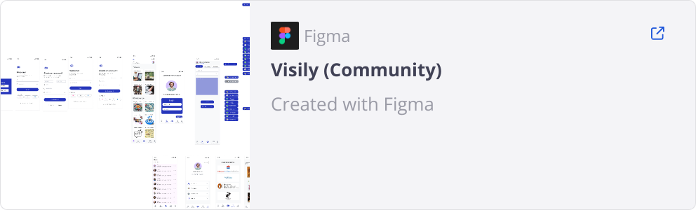
PROTOTYPE
Notes:
8

Slide 10
Competitive Advantage: A Unique Approach
Unique Collaboration
AI-Driven Efficiency
Access to Resources
Cultural Inclusivity
Automating content creation and validation.
Centralized access to historical references and cultural databases.
Focuses on diverse, global cultural representation.
Bringing authors, educators, and historians together.
Scalability
Publication Services
Multilingual and adaptable for both the global book market and education sectors.
Simplifies publishing processes for creators
Notes:
9

Slide 11





Market Potential and Impact: Reaching Global Audiences
Target Audience
Market Trends
Rising demand for culturally relevant books and educational resources.
Schools
publishers,
Libraries
Museums
NGOs focused on cultural preservation.
Impact
Growth of the global e-learning market.
Increased interest in publishing diverse cultural literature for global audiences.
Promotes global cultural exchange and understanding.
Makes education more inclusive.
Enriches the cultural book market with authentic, diverse stories.
Preserves cultural heritage for future generations.
Notes:
10

Slide 12
Advanced Tools and Future Enhancements
Voice-to-Text Integration
Mood-Based Backgrounds
Customizable AI Assistants
Allow contributors to narrate stories or lessons, converting them directly into editable text.
The app now adapts its background visuals based on your mood—calm, focused, energized, or creative—to create a personalized writing and reading experience.
Personalized AI assistants tailored to individual contributor needs (e.g., for educators, historians, or authors).
Blockchain for Copyright Protection & Marketing for Authors
Learning Paths (AI-powered)
AI-Driven Community Matching
Personalized learning experiences for students and educators.
To secure content ownership and prevent unauthorized use and dedicated space for authors to promote their books, connect with readers, and showcase their writing journey—all within the app.
Match contributors with similar interests or complementary skills for efficient collaboration.
Interactive Learning Modules
Open API Ecosystem
AI-Powered Analytics
Enable seamless integration with existing education or publishing platforms.
Track content impact through user feedback and engagement metrics. Provide insights on trending cultural topics and regions for targeted content creation.
Integrate gamification for student-friendly engagement with cultural content.
Notes:
11

Slide 13

Conclusion: Embracing Collaboration for Cultural Preservation
A movement to preserve, promote, and share cultural heritage through technology and collaboration.
Brings together authors, educators, and historians for co-creation.
Powered by AI tools: ChatGPT, Quill Bot, Plagium, Midjourney, Humanize AI.
Ensures content that is: • Accurate • Inclusive • Engaging • Culturally significant
Offers tools to create, validate, and publish culturally rich educational materials.
Together, we aim to:
Enrich education
Preserve cultural heritage
Foster global cultural exchange
Let’s make storytelling more authentic, impactful, and inclusive for future generations.
Join us on this journey to redefine storytelling and education with Cultural Hub!
Notes:
12

